Slide 1

Goal setting & Tracking
Semester 3 – Professional Communication Skills (303193203)

Slide 2
Learning Objectives
Understand the significance of goal setting in personal and professional life.
Differentiate between life, personal, and professional goals.
Develop SMART goals and align them with personal vision.
Apply practical strategies to monitor and achieve performance goals.
Design action plans to overcome challenges and sustain motivation.

Slide 3
Introduction-Activity-What’s Your Goal?
Instructions:
Draw or display a large dartboard-style target (physically or on the board) with 3 zones:
  Inner Circle: Long-Term Goals
  Middle Circle: Short-Term Goals
  Outer Circle: Daily Tasks
Ask each student to take a sticky note (or card) and write down one personal or academic goal they have in mind.
One by one, students come up and place their note on the target, where they feel their goal fits (long-term, short-term, or daily).
After everyone places their note, pick a few at random and discuss how such goals can be achieved, leading into the importance of setting and tracking goals.

Slide 4
Importance of Goal Setting
Provides Direction and Motivation
Setting clear goals gives you a path to follow and keeps you motivated to work towards something meaningful.
Enhances Self-Confidence
Achieving small goals builds confidence, showing you that your efforts lead to success.
Helps Track Personal and Professional Development
Goals allow you to measure your growth, identify strengths, and work on areas of improvement over time.
“Vision without action is a daydream; action without vision is a nightmare.” – Japanese Proverb

Slide 5
What is Goal Setting?
Defining goals means setting a personal or professional destination.
It gives you a clear idea of what you want to achieve.
Goals act like a map to guide your performance and effort.
They help you stay focused, organized, and purposeful in your actions.

Slide 6
Why Goal Setting is Important?
Clarifies Expectations
Goals define what needs to be achieved, making priorities and outcomes clear.
Encourages Consistent Effort
Having a goal keeps you focused and motivated to take regular action.
Allows Measurable Progress
Goals make it easy to track how far you’ve come and what still needs to be done

Slide 7
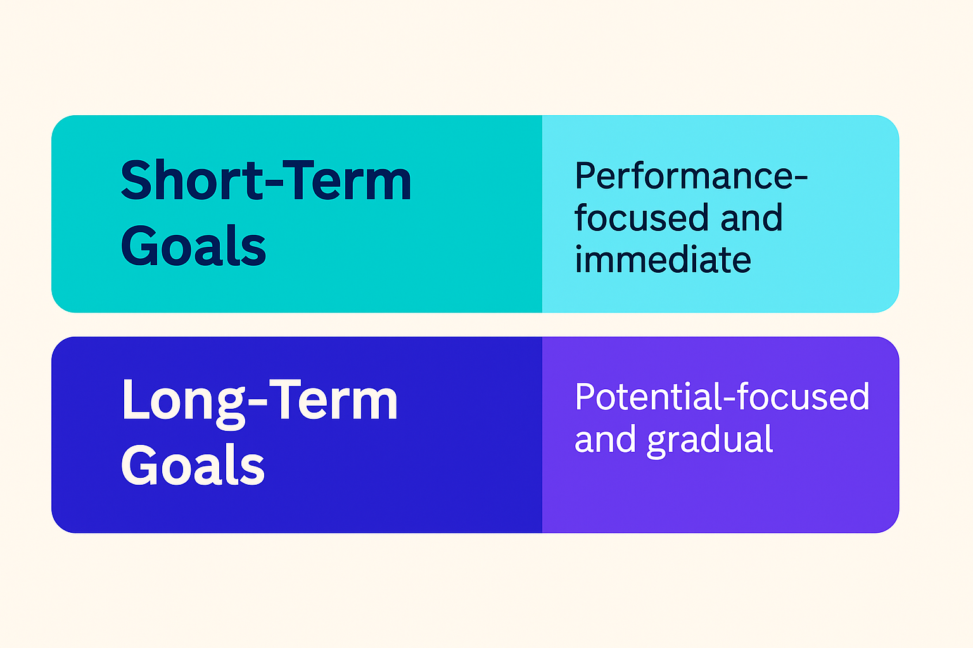
Types of Goals
Short-Term Goals
Focus on immediate tasks and performance improvements.
Example: Submitting assignments on time, improving a subject grade this semester.
Long-Term Goals
Aim at overall growth and future potential.
Example: Becoming a software engineer, securing a dream job, or pursuing higher studies.
These two types of goals work together — short-term goals build the path to achieving long-term success.

Slide 8
SMART Goals
SMART goals help you plan effectively by ensuring your goals are:
Specific
Clearly state what you want to achieve.
Measurable
Define how you will track your progress and success.
Achievable
Set realistic goals that are within your ability and resources.
Relevant
Ensure the goal aligns with your broader objectives and priorities.
Time-bound
Set a clear deadline to stay focused and motivated.

Slide 9

SMART Goals
• Specific
• Measurable
• Achievable
• Relevant
• Time-bound

Slide 10
The Goal Setting Process
Define Outcome Goal
Set a clear long-term goal that you want to achieve.
Identify Performance Goals
Break down the outcome into 2–3 focused short-term goals that support it.
Break Them into Process Goals
List specific daily or weekly actions needed to achieve each performance goal.
Track and Evaluate Regularly
Monitor your progress, make adjustments if needed, and review your performance over time.

Slide 11
Tracking Your Progress
Break Goals into Smaller Tasks
Divide big goals into manageable steps to stay organized and motivated.
Daily/Weekly Review
Regularly check your progress to stay on track and maintain consistency.
Adjustments When Needed
Be flexible—revise your plan if something isn't working.
Focus on Effort, Not Just Outcome
Concentrate on consistent actions, as results will follow with steady effort.

Slide 12
Challenges in Goal Setting
Unclear Expectations
Goals that are vague or not well-defined can cause confusion and lack of focus.
Fear of Failure
Doubts or fear of not succeeding can stop you from even starting.
Lack of Tracking and Feedback
Without regular monitoring, it’s hard to measure progress or improve performance.
Procrastination
Delaying actions can prevent goals from being achieved on time.

Slide 13
Activity 1 -Step Goal Planner
Instructions:
Students form pairs.
Each student selects one personal or academic goal (e.g., Improve English, Get a 9 SGPA).
Using the 3-Step Goal Planner template, they complete:
  Outcome Goal
  3 Performance Goals
  3 Process Goals for each performance goal
Partners give feedback on each other’s plans.
Selected pairs present their goals to the class for discussion.
Focus on setting SMART goals and breaking them into clear, actionable steps.

Slide 14
Activity 2 -Goal Mapping Wall
Instructions:
Divide the class into small groups (3–4 students each).
Provide each group with chart paper or space on a board.
Each group chooses a common goal (e.g., "Crack campus placement", "Build a mini project", "Improve CGPA").
They must map the path to this goal using:
  Outcome Goal at the top
  Performance Goals in the middle
  Process Goals as branches or steps underneath
Encourage the use of symbols, arrows, and color coding to visualize steps clearly.
Groups present their goal map to the class.

Slide 15
Conclusion
Recap of key points:
Goal setting is a skill that brings clarity, direction, and confidence.
SMART goals help make dreams achievable.
Tracking keeps motivation alive and helps evaluate progress..

Slide 16
Learning Outcomes
By the end of this two-hour session, students will be able to:
Define and classify short-term and long-term goals.
Use SMART criteria to write effective goals.
Break down complex goals into actionable steps.
Monitor and adjust progress using tracking tools.
Apply strategies to overcome setbacks and stay committed.

Slide 17
Thank You

